Slide 1
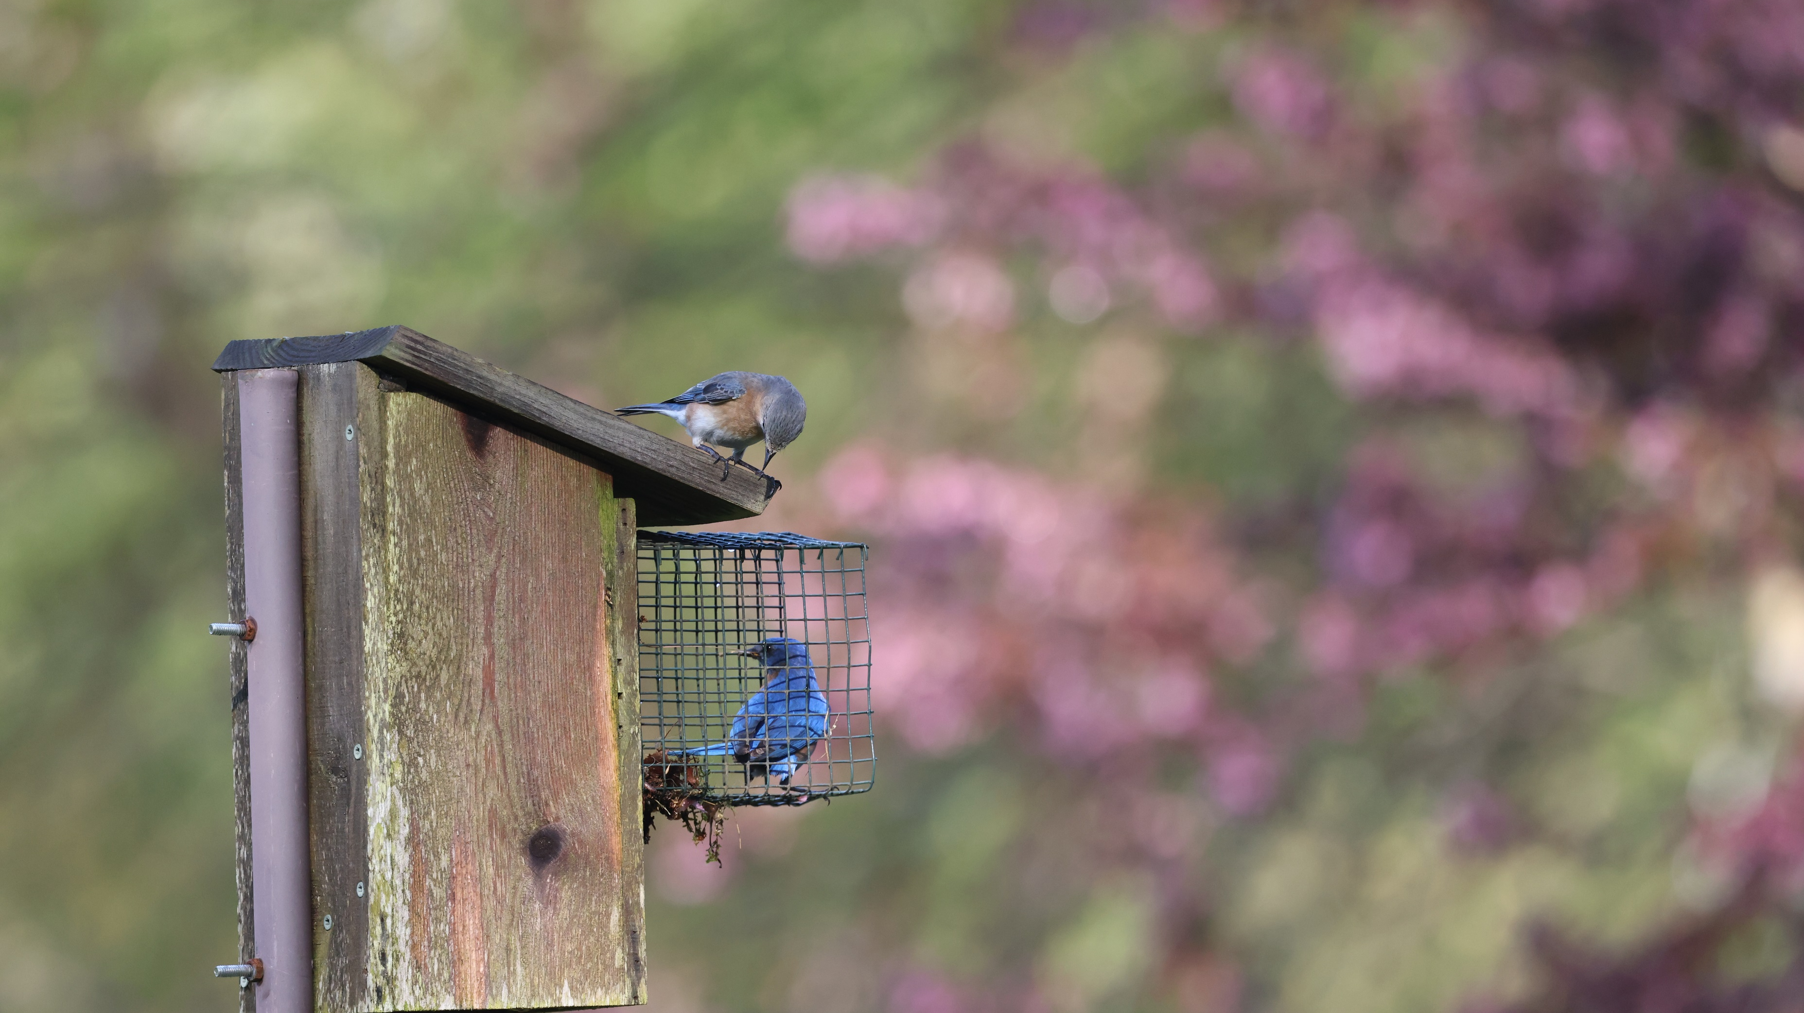
Earth Keeping
Since the well-being and proper functioning of ecosystems are greatly influenced by our actions as humans, we need to encourage each other to do what we can to promote the health of the environment around us. The “earth keeping” endeavors in this section and suggestions for responsible actions will assist you in knowing how you can play your role as a caretaker.

